Slide 1

Learning through different modalities:
Comparison between visual stimuli and auditory stimuli through the participants’ ability to recall items.
Fiammetta Caccavale & Rasmus Kær Jørgensen
14.03.2018

Slide 2
Content
Introduction
Hypothesis
Background Studies
Preliminary Tests
Experimental Design
Results
Conclusion
Keywords
Spatial Learning; Spatial Memory; Visual Stimuli; Auditory Stimuli; Sensory Modalities

Slide 3
Introduction
This study examines multimodal perception and how the integration of different sensory modalities can ease learning.
The idea:
Investigate spatial perception through different modalities and multi-modal integration.
The aim:
Evaluate the recall of items, presented to the participants through visual, auditory and multisensory modalities.
Notes:
Of a spatial environment

Slide 4
Hypothesis
Subjects exposed to visual stimuli will remember the objects in a more precise manner since the study deals with locations and spatial perception, while the group that was exposed to auditory stimuli will have lower performances.
Improvement in the group exposed to multimodal integration vs only auditory stimuli.
Moreover, the intent is to verify what researchers are hypothesizing concerning applications such as Virtual Reality, that the strong element of visual stimuli ​ ​and ​ ​interactive ​ ​ability ​ ​are ​ ​well ​ ​suited ​ ​to ​ ​educate ​ ​and ​ ​train ​ ​people.

Slide 5
Background Studies
Comparison between real navigation and virtual navigation
Thorndyke, PW & Hayes-Roth, B., 1982
Zhang, Hui & Zherdeva, Ksenia et al., 2014
Participants exposed to visual stimuli had a superior performance to participants exposed to auditory stimuli. Bigelow, James & Poremba, Amy. 2014
Auditory stimuli to be more effective than visual stimuli. Corballis, M. C., 1966
In general, the studies do agree that a combination of both visual and auditory stimuli produces ​ ​the ​ ​best ​ ​results. Jensen, Arthur R., 1971, Nicolas Guichon, Sinead Mclornan, ​2008
Notes:
In the 19th century and early 20th century most studies seeked to answer the question of whether people learn and remember better from visual or auditory presentation of material. if the subject is exposed in an adequate way to the virtual stimuli, they can learn the characteristics of the environment as much as the subjects that concretely visited it and had a real experience of it

Slide 6
Preliminary Tests
The experiment also aims to verify
if the potential differences are ascribable exclusively to the modality in which the environment is presented, or
if there are individual differences among the group of participants, for example if the gender can introduce differences in certain kind of tasks (Lawton, 1994)
Individual differences were evaluated through balanced tests, such as sMRT (Vandenberg & Kuse, 1978), Spatial Anxiety Test (De Beni et al., 2014; originally Lawton, 1994), Questionnaire Towards Orientation Tasks (De Beni et al., 2014) and the Spatial Orientation Questionnaire ​ ​(Pazzaglia, ​ ​Cornoldi ​ ​e ​ ​De ​ ​Beni, ​ ​2000)
Notes:
These tests were necessary to evaluate the individual abilities of the participants, to check that the groups were balanced, implying that it is to avoid to have a group were the participants are significantly more confident in new environments and with mental representations. They allow us to have objective results. In fact, if an individual is particularly confident in this areas, the method used to test them would probably not influence the performance and therefore they would bias the data.

Slide 7
Results on the Preliminary Tests
Preliminary evaluations of the individual differences showed:
The three groups were balanced:
Gender and visual-spatial abilities of the participants do not introduce significant​ ​differences.

Slide 8
The Experiment: The Participants
Learning Methods:
Group 1: Visual stimuli
Group 2: Auditory stimuli
Group 3: Multi-modal integration of visual and auditory stimuli
Evaluation:
All participants are tested on the same two tasks:
Free Recall
Serial Recall
 | Video Group | Audio Group | Audio & Map Group
Group | 1 | 2 | 3
Participants | 6 | 6 | 6
Gender | 3 males/ 3 females | 3 males/ 3 females | 1 males/ 5 females
Age (avg) | 25.67 | 24.33 | 24.16
Years of Education (avg) | 17.67 | 17.17 | 17.00
Table explaining the participants in each group for the analysis.

Slide 9
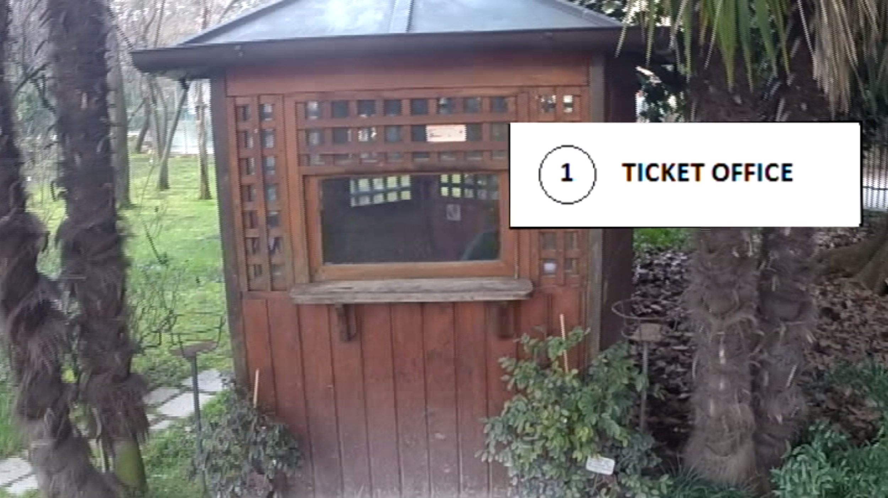
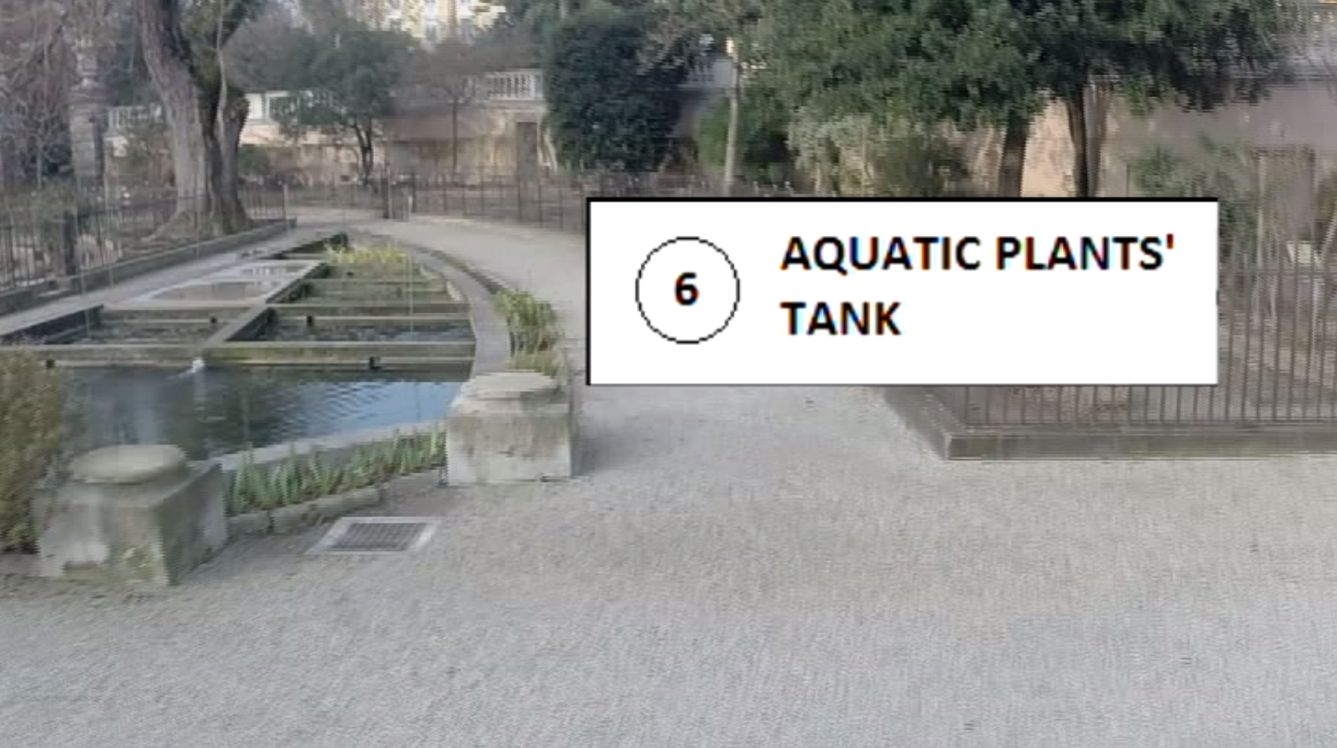
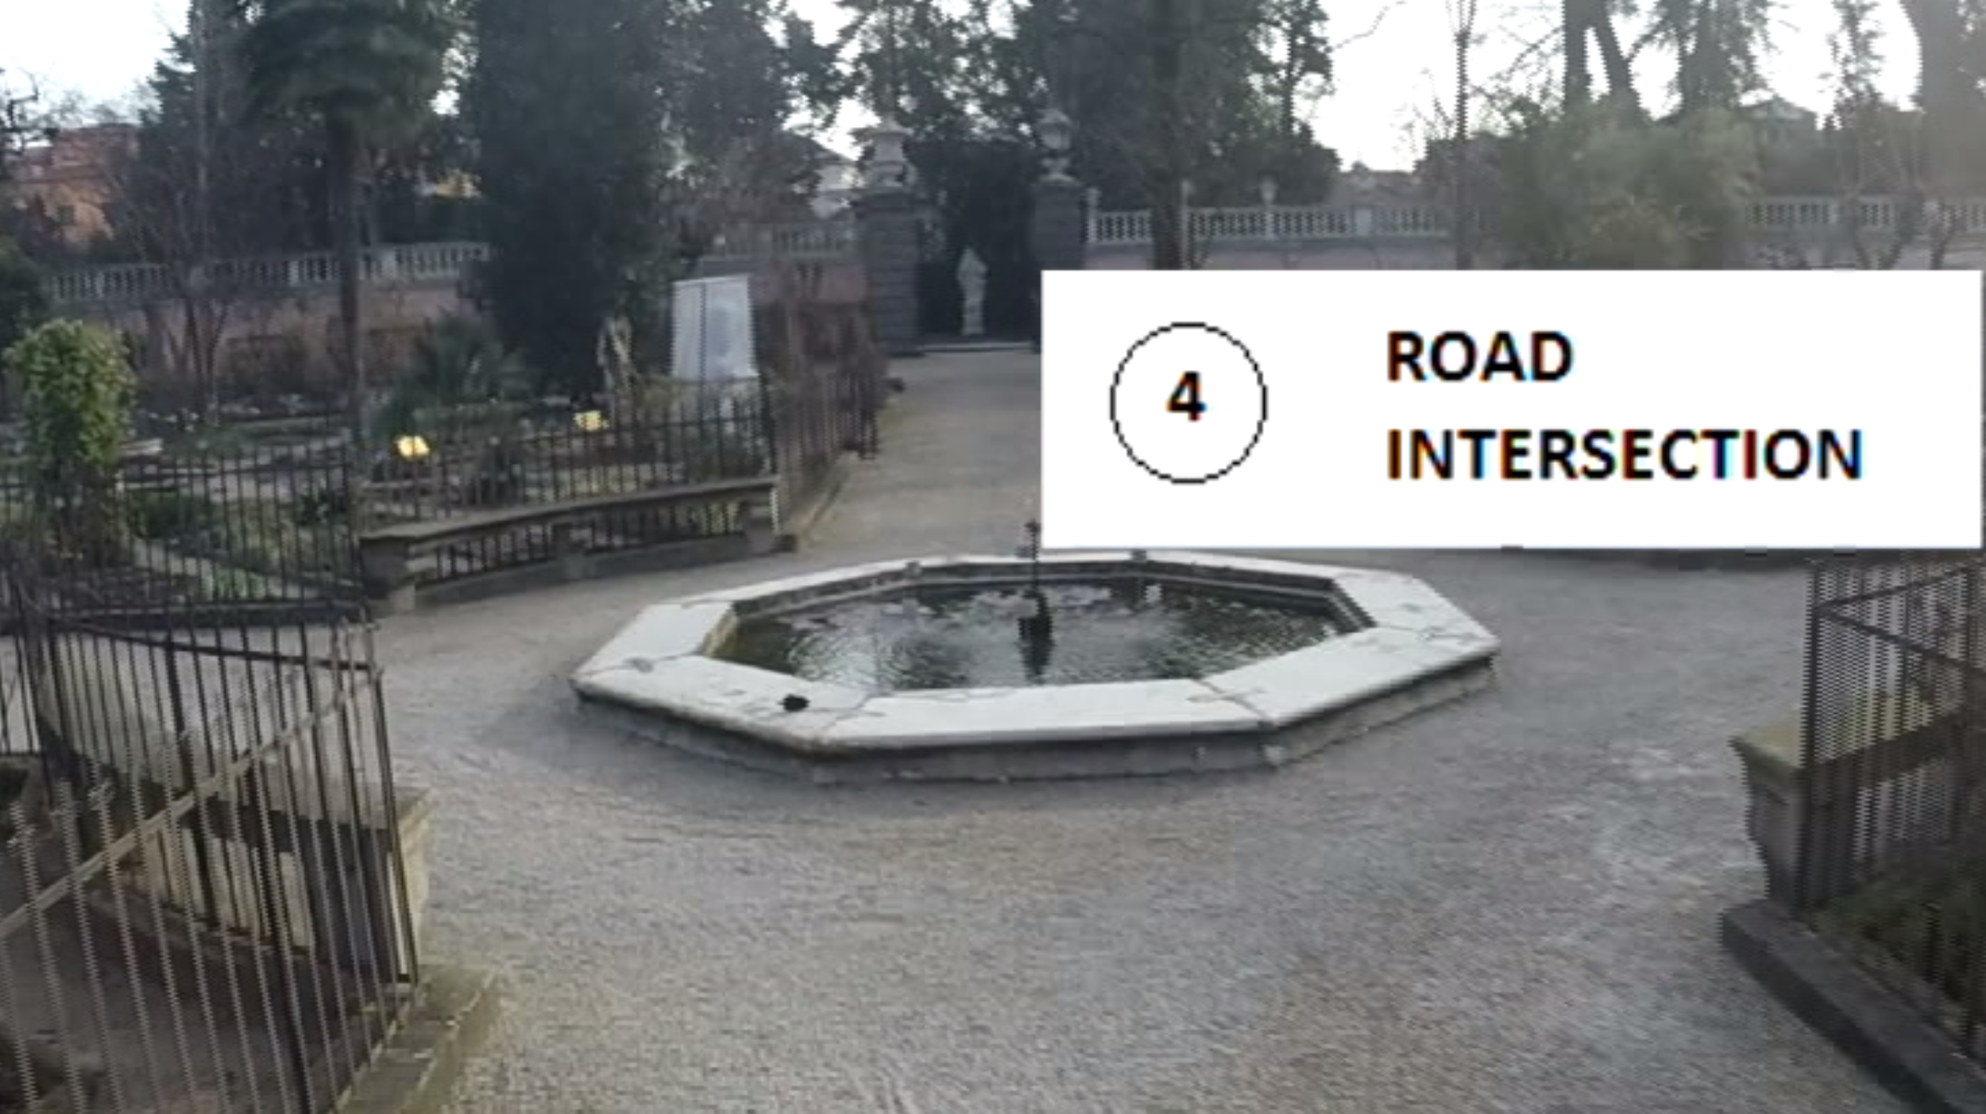
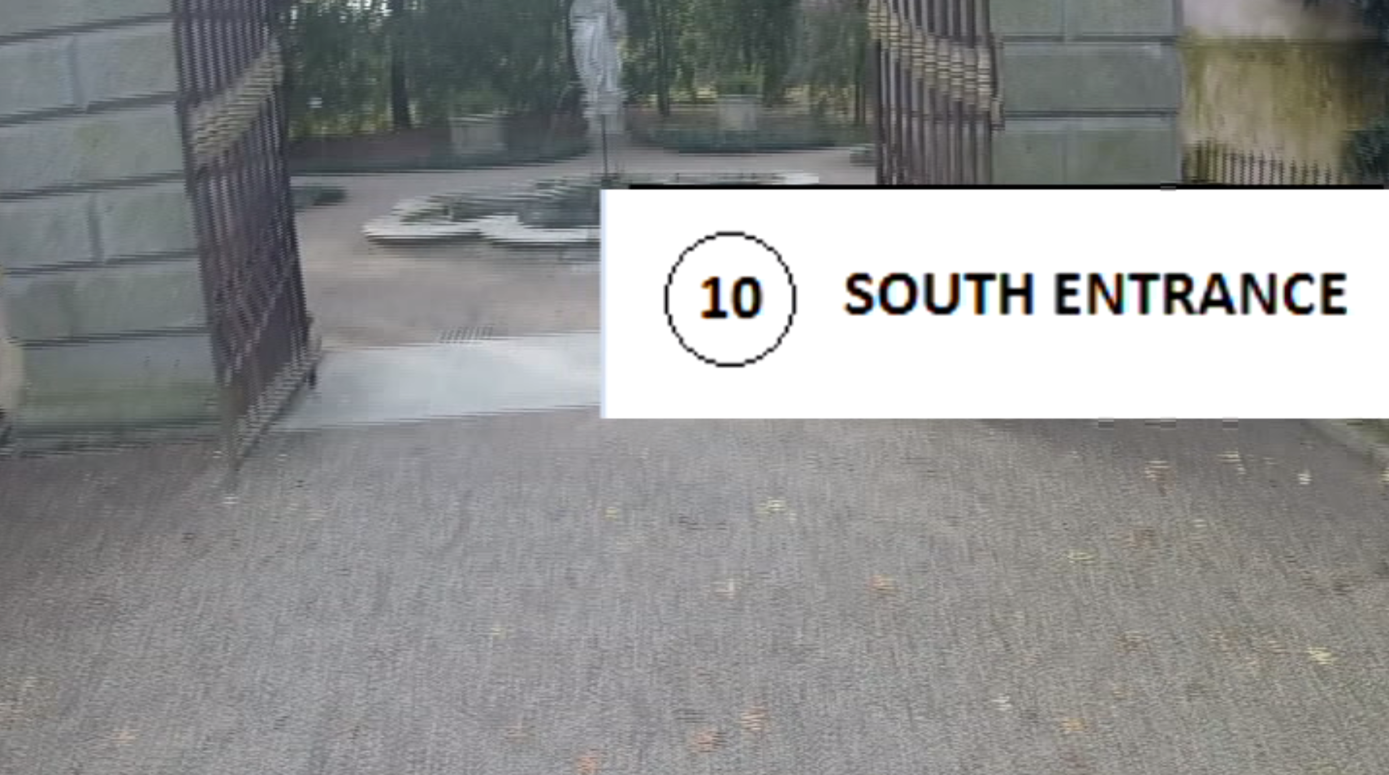
Visual Stimuli
The visual stimuli consists of a video that navigates the participant through a walk in the Botanical Garden of Padova, Italy.
The video presents the landmarks as tags on the place or object that the ​ ​participant ​ ​has ​ ​to ​ ​remember.
Screenshots from the video.

Slide 10
Auditory Stimuli
The auditory stimuli is a recording of the same path, where the emphasis of the voice is used to mark ​the ​landmarks.
The duration of the name representing the landmark lasts 3 seconds.

Slide 11
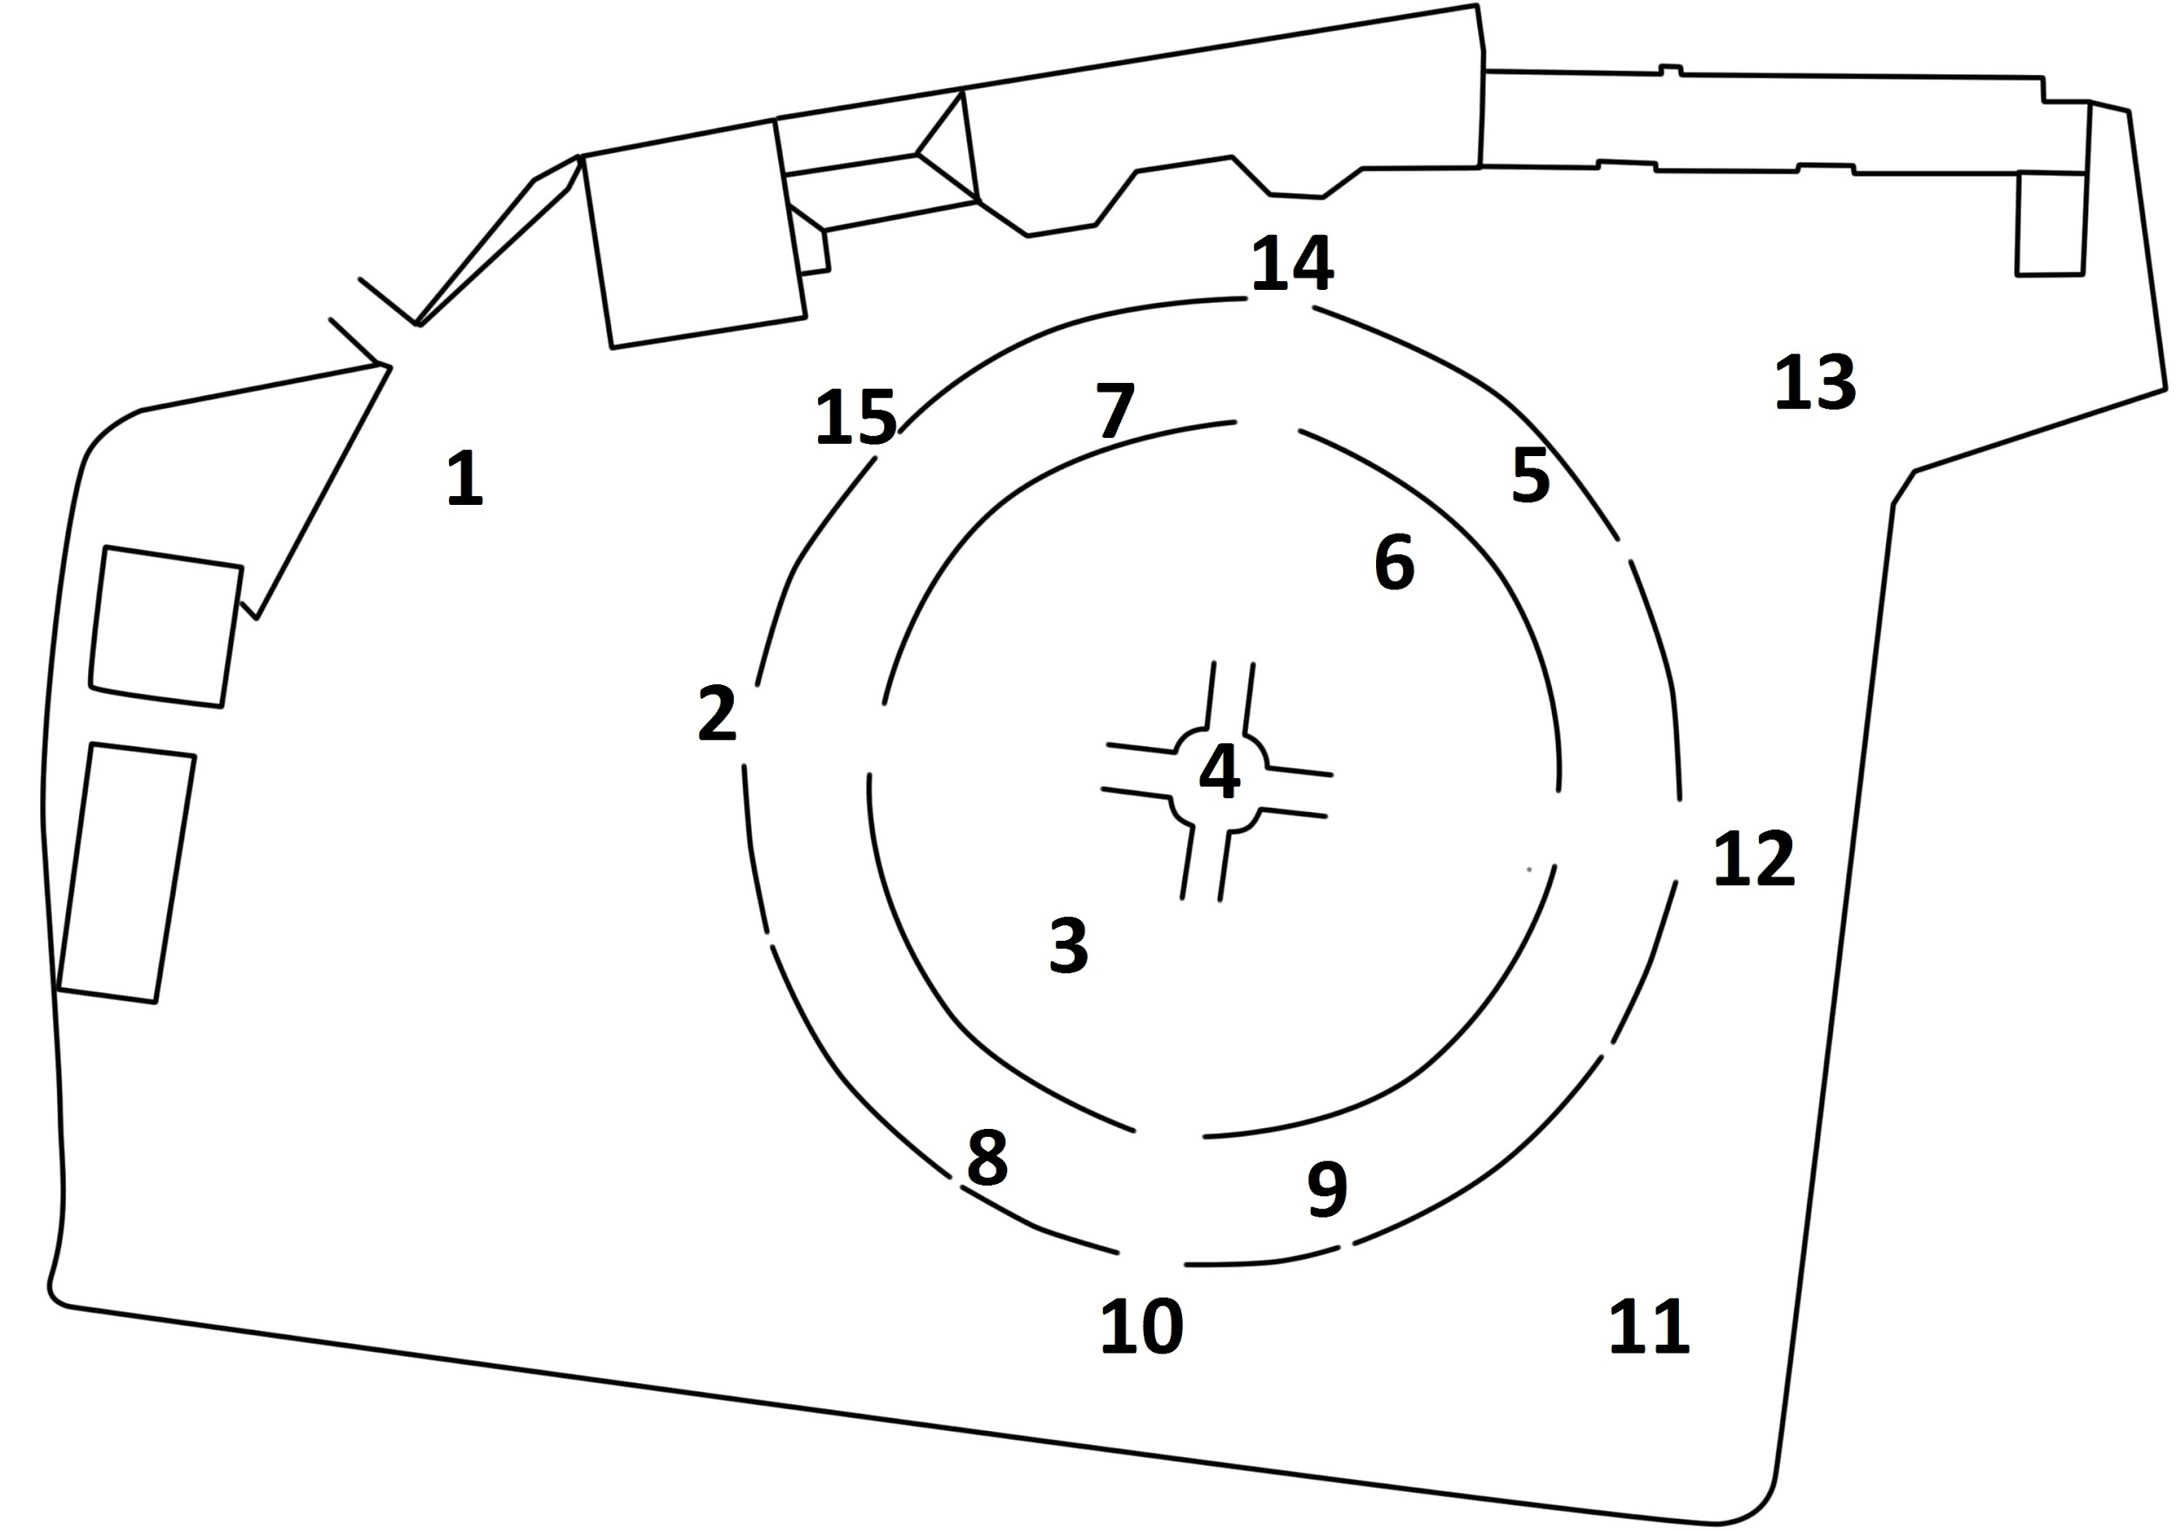
Multi-Modal Integration of Visual and Auditory Stimuli
The participants of the third group were given
the audio recording of the path with
the supplement of a map that only displays the numbers associated with each landmark, not the names ​ ​themselves.
Map used to orientate the participant.

Slide 12
Two Main Tasks
Free Recall (of the items)
the participants were asked to recollect and write all the landmarks of the Botanical Garden that they could remember, the order in which they recalled the items was not evaluated
Serial Recall (of the items)
the list of landmarks was given. The task ​ ​was ​ ​to ​ ​sort ​ ​the ​ ​landmarks ​ ​in ​ ​order ​ ​of ​ ​appearance

Slide 13
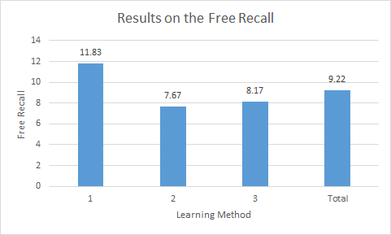
Results - Free Recall
Significant differences associated with ​​the ​stimuli ​ ​the ​ ​subjects ​were ​exposed ​to.
Group 1 had the highest precision in remembering the correct names.
Chart summarising results of the Free Recall.

Slide 14
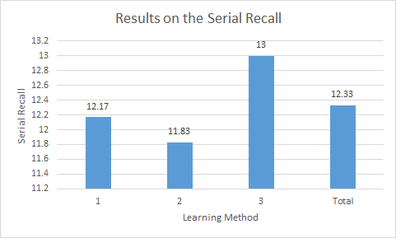
Results - Serial Recall
No significant differences between Group 1 and Group 2.
The multisensory stimuli group had the highest ​ ​results ​ ​in ​ ​this ​ ​task.
Chart summarising results of the Serial Recall.

Slide 15
Conclusion
The results and findings concludes,
Group 1 (visually navigated) performed superior to Group 2 (aurally navigated).
Group 1 was better at recalling the objects and able to describe them more precisely.
This study also found an indication of multisensory integration of audio plus a map to be significantly better than only auditory stimuli, but not better than visual stimuli.
Virtual Reality for learning could have the potential to create new and better ways to educate and train people compared to auditory learning.

Slide 16
Further Studies
Virtual Reality in 3D with a 360 degree view-span.
The change in apparatus would give the participants the experience of depth in their vision and close out for surrounding noise and thereby increasing their focus.
To investigate the element of retention to see how well the participants retain information.
This would give a wider picture of learning, beyond short-term memory.
More data, more participants.

Slide 17
Thanks for your attention!

